Slide 1
OEHS Academy New and Aspiring Principals OEHS Responsibilities
Presented by:
Office of Environmental Health and Safety
Modification Date: 1-18-14

Slide 2
OEHS Programs
Major OEHS programs that affect school sites:
Injury and Illness Prevention Plan
OEHS Webpage Administrators Portal
Accident Prevention
School Site Requirements
Safe School Inspection Program

Slide 3
Injury and Illness Prevention Plan
Is a written plan followed by school site staff to assure consistent implementation of District safety requirements.
Proper implementation reduces and/or prevents costly injuries and illness at your school.
Proper implementation assures regulatory compliance at school sites.

Slide 4
Injury and Illness Prevention Plan
The plan consist of seven required components:
Designate a responsible individual
Employee compliance with health and safety regulations (safe work practices)
Effective communication
Workplace hazard assessment and correction
Accident investigation and reporting
Training
Recordkeeping

Slide 5
Injury and Illness Prevention Plan
All the material needed to complete the site IIPP is accessible via the OEHS webpage.

Slide 6
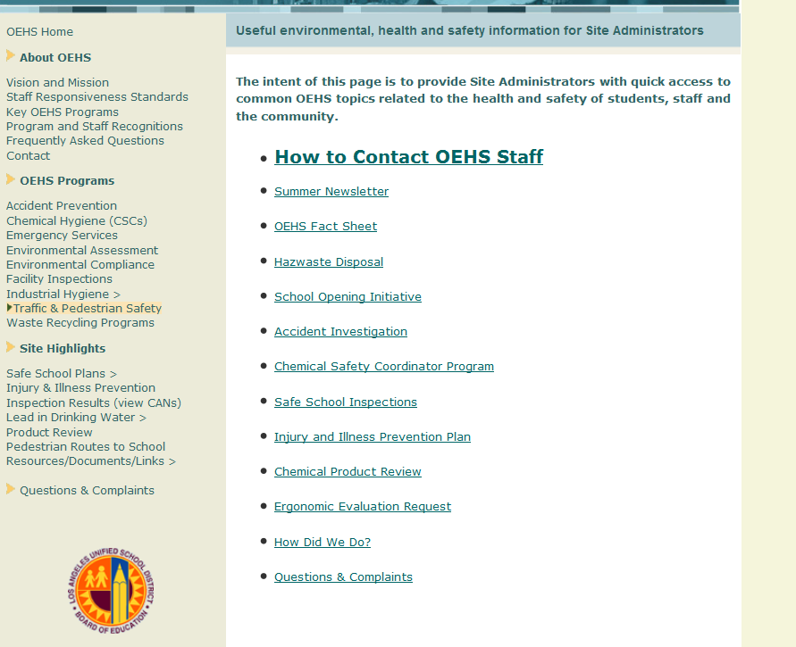
OEHS Webpage
Administrators Portal
Common content frequently used by Site Administrators

Slide 7
Accident Prevention
Accident prevention is everyone’s responsibility
Employer’s responsibility
Provide safe work environment
Comply with all health and safety requirements
Investigate accidents
Employee’s responsibility
To work safely and avoid accidents
Report unsafe conditions

Slide 8
Accident Prevention
The key to preventing accidents is…
An effective Injury and Illness Prevention Program (IIPP)
Required by Cal OSHA
Outlines responsibilities and procedures
Use OEHS template to prepare IIPP
www.lausd-oehs.org
213-241-3199

Slide 9
School Site Requirements
The following pages outline specific OEHS programs that may be required at school sites.
For specific direction on which requirements are applicable, please contact your Educational Service Center safety officer or OEHS at 213-241-3199.

Slide 10
School Site Requirements
DESCRIPTION OF SCHOOL SITE TASK | SCHOOL LEVEL | RELATED BULLETIN, REFERENCE GUIDE, MEMO OR DISTRICT GUIDELINES
Conduct fire drill (monthly) and earthquake drill (monthly) | Elementary and Middle | REF-1314.1 Emergency Drills and Procedures
Conduct fire alarm tests (monthly) | All Schools | REF-1314.1 Emergency Drills and Procedures
Inspections of all chemical and hazardous waste storage areas | Secondary sites participating in program | REF-1563.2 Chemical Safety Coordinator
Site Chemical Safety Coordinator attended biannual Chemical Safety Coordinator training | Secondary sites participating in program | REF-1563.2 Chemical Safety Coordinator
Certify IIPP Implementation | All schools | BUL-3772.2Injury and Illness Prevention Program Requirements
Daily flushing of drinking fountains and monthly electronic certification | All schools | REF-3930.3 Daily Flushing Requirements for Drinking Fountains
Notification by OEHS regarding high temperature episodes. Upon notification school are required to implement steps outlined in procedure. (approximately 5 notifications in month) | All schools | BUL 963.1 Guidelines for Preventing Heat Stress
When sites are visited by a regulatory agency, procedures are implemented to manage site visit and follow up. | All schools | BUL 5547Procedures for Regulatory Agency Inspections and Industrial Hygiene Sampling

Slide 11
School Site Requirements
DESCRIPTION OF SCHOOL SITE TASK | SCHOOL LEVEL | RELATED BULLETIN, REFERENCE GUIDE, MEMO OR DISTRICT GUIDELINES
Monthly fire alarm test/system test | All schools | REF-1909.1 Procedures for Fire Protection Systems
Monthly fire extinguisher test | All schools | REF-1909.1 Procedures for Fire Protection Systems
Required notification and pick up of hazardous waste from | All schools | REF-4149.0 Disposal of Hazardous Waste and Universal Waste
Enhanced recycling training for Plant Managers, B&G Workers and Food Services staff | All schools | Memo 5696.0 Update to Rubbish and Recycling Services Program
Community awareness environmental/recycling seminar by City of Los Angeles | All Schools | Memo 5696.0 Update to Rubbish and Recycling Services Program
Conduct Safe School Inspection (SSIP Program) at site (approximately 35 per month). | All Schools | LAUSD OEHS Safe School Inspection Guidebook, April 2011
Conduct accident investigations for work-related injuries | All schools | Safety Alert 04-14 Accident Investigation and Reporting; BUL-5256 Incident Tracking and Accountability Report

Slide 12
School Site Requirements
DESCRIPTION OF SCHOOL SITE TASK | SCHOOL LEVEL | RELATED BULLETIN, REFERENCE GUIDE, MEMO OR DISTRICT GUIDELINES
County of Los Angeles Health Inspectors will conduct school cafeteria public health inspections twice a year | All schools | REF-5830 Safe Food Inspection Program
Prior to use inspection of all in-wall tables and benches | All schools | Safety Alert 11-01 In-wall Tables and Benches
OEHS staff will conduct traffic safety site evaluations: when requested. | All Schools | REF 4492.1 School Traffic Safety
Implement School Drop-off Valet Program: when requested | All Schools | REF 5496.1 Implementing a Safety Valet Program at Schools
OEHS staff conducted methane safety awareness Training for Schools with methane systems | All schools with methane systems | REF 5671.0 Methane Safety Program Implementation Guidelines
OEHS staff works with Site Administrator to prepare and submit business plans to Certified Unified Program Agency (CUPA) (approx. 7 plans completed in a month) | Middle & High Schools | OEHS Hazardous Waste Management Procedures for Schools, September 2002

Slide 13
Safe School Inspection Program
In 2001, routine health and safety inspections were initiated in all District schools to assess compliance with Federal, State and District requirements.
The inspections are designed to assess compliance with 14 health and safety standards. Each of these standards are in the Safe School Inspection Guidebook.
At the time of each inspection, the OEHS inspector documents necessary corrective action, and issues a Corrective Action Notice and Compliance Scorecard.

Slide 14
Questions
Please contact the Office of Environmental Safety and Health at 213-241-3199 or visit the OEHS website.

